Slide 1
Dbms LECTURE 2ND
PARUL MADAN (CSE)
GEU

Slide 2

What is file handling?
Files need to be handled by set of programs
This bunch of programs is a part of actual application.
Database
Business Logic
User Interface
File handling
Secondary Storage

Slide 3
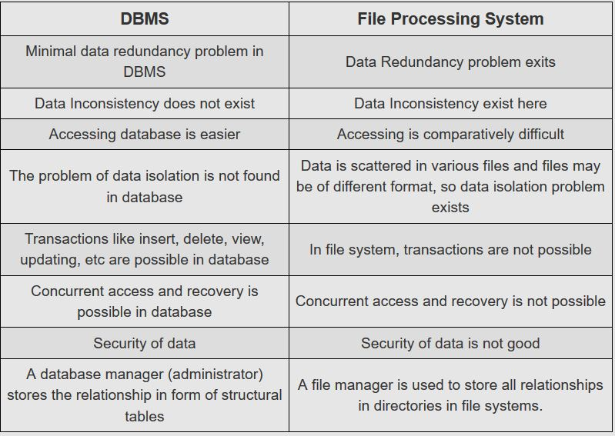

Slide 4
IMPORTANCE OF DBMS
MAINTAIN DATA REDUNDENCY: in traditional file system , duplicate data is created in many places because all the programs have their own files. This creates data redundancy which in turns waste labor and space . In DBMS all files are integrated in single database . The whole data is stored at single place so there is no chance of duplicate data. For eg: library management system.
SHARING OF DATA: In DBMS , data can be shared in between authorized user of database. All the users have their own right to access the database up to a level. Database Administrator(DBA) has a complete access of database, he has an authority to create different users and assign privileges to access the complete or part of database.

Slide 5
3. DATA CONSISTENCY: DBMS controls data redundancy which in turn controls data inconsistency. Data consistency means if you want to update data in any file then all the files should not be updated again. As in DBMS, data is stored in a single database so that data become more consistent in comparison to file processing system. Also all the updated values are available to all the users immediately.
4. DATA INTEGRITY: unification of so many files into a single file . In DBMS data is stored in so many tables and these tables are linked to each other . Many users feed entries in these tables so it is important to maintain data items and association between data items .DBMS allows data integrity that makes it easy to decrease data duplicity, data integrity reduces redundancy as well as data inconsistency.

Slide 6
5. Search capability: users of database may require to fetch data from the database. There are numerous queries user may ask about data, search speed should be fast to produce quick results. If user executes any query then it is required that he gets fastest result from the database. It is an objective of DBMS to maintain flexible search capability.
6. Security: data security meant to protect your precious data from unauthorized access . Data in database should be kept secure and safe to unauthorized modifications .Only authorized users should have grant to access the database . There is a username set for all users who access the database with password so that no other guy can access these information's . DBMS always keep database temper proof , secure and theft free.

Slide 7
7. Privacy: means what extent a user can access data. It is predetermined by the DBA that who will access the data and up to what level he will be able to access it . Let say you have a Facebook page then you have a power to give rights to other users that who will be the promotor , editor and admin.
8. Simplicity : means to represent overall logic view of data in a simple and clear manner .DBMS is very simple for the users who uses it. All the operations like insert , delete , create and update are very easy to implement.

Slide 8
9. Backup and Recovery : Data loss is a big problem for all the organizations . In traditional file system, user needs to backup database after regular interval of time that waste lots of resources and time . If volume is large then this process may take a very long time.
10. Integrity constraint: constraint are used to store accurate data because there are many users who feed data in the database . Data stored in the database should always be correct and accurate. DBMS enforce these constraints on database.
For ex: maximum marks obtained by student should not more than 100.

Slide 9
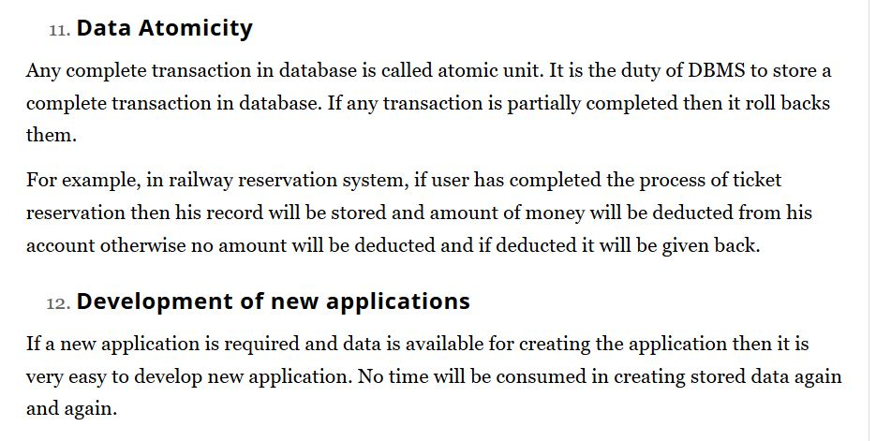

Slide 10
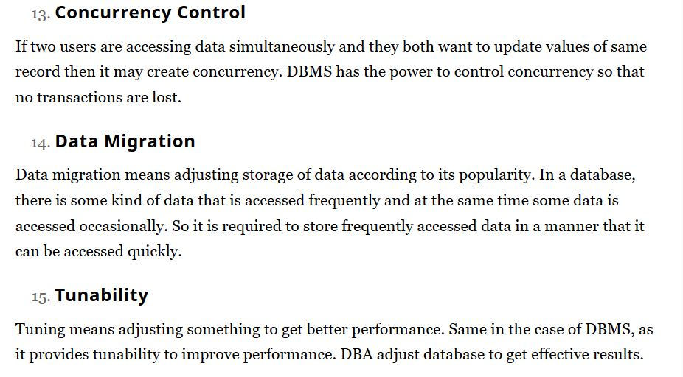

Slide 11
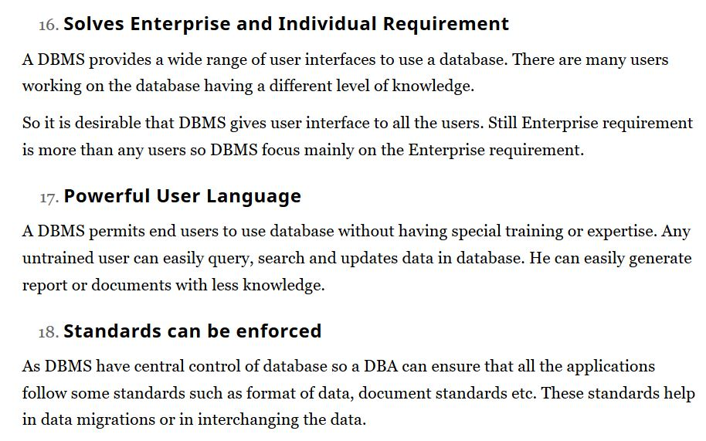

Slide 12
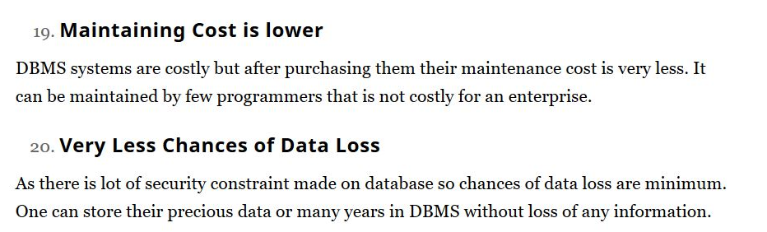

Slide 13
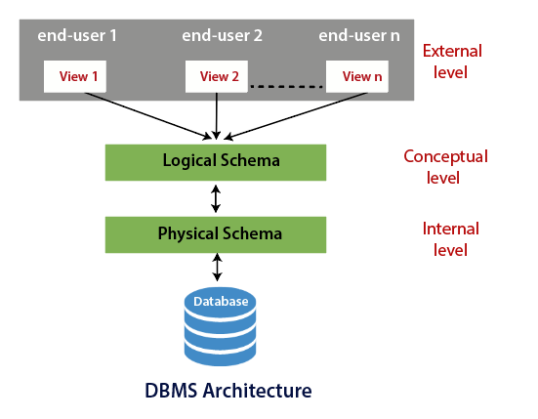
3 SCHEMA Architecture of DBMS

Slide 14
Three Schema Architecture of DBMS
External or View level: This is the highest level of database abstraction. External or view level describes the actual view of data that is relevant to the particular user. This level also provides different views of the same database for a specific user or a group of users. An external view provides a powerful and flexible security mechanism by hiding the parts of the database from a particular user.
Conceptual or Logical level: The conceptual level describes the structure of the whole database. This level acts as a middle layer between the physical storage and user view. It explains what data to be stored in the database, what relationship exists among those data, and what the datatypes are. There is only one conceptual schema per database.
Database administrator and the programmers work at this level. This level does not provide any access or storage details but concentrates on the relational model of the database. The conceptual schema also includes features that specify the checks to retain integrity and consistency.

Slide 15
Internal or Physical level: This is the lowest level of database abstraction. It describes how the data is actually stored in the database and provides methods to access data from the database. It allows viewing the physical representation of the database on the computer system. The interface between the conceptual schema and the internal schema identifies how an element in the conceptual schema is stored and how it may be accessed.
If there is any change in the internal or physical schema, it needs to be addressed to the interface between the conceptual and internal schema. But there is no need to change in the interface of a conceptual and external schema. It means that the changes in physical storage devices such as hard disks, and the files organized on storage devices, are transparent to application programs and users.

